Slide 1
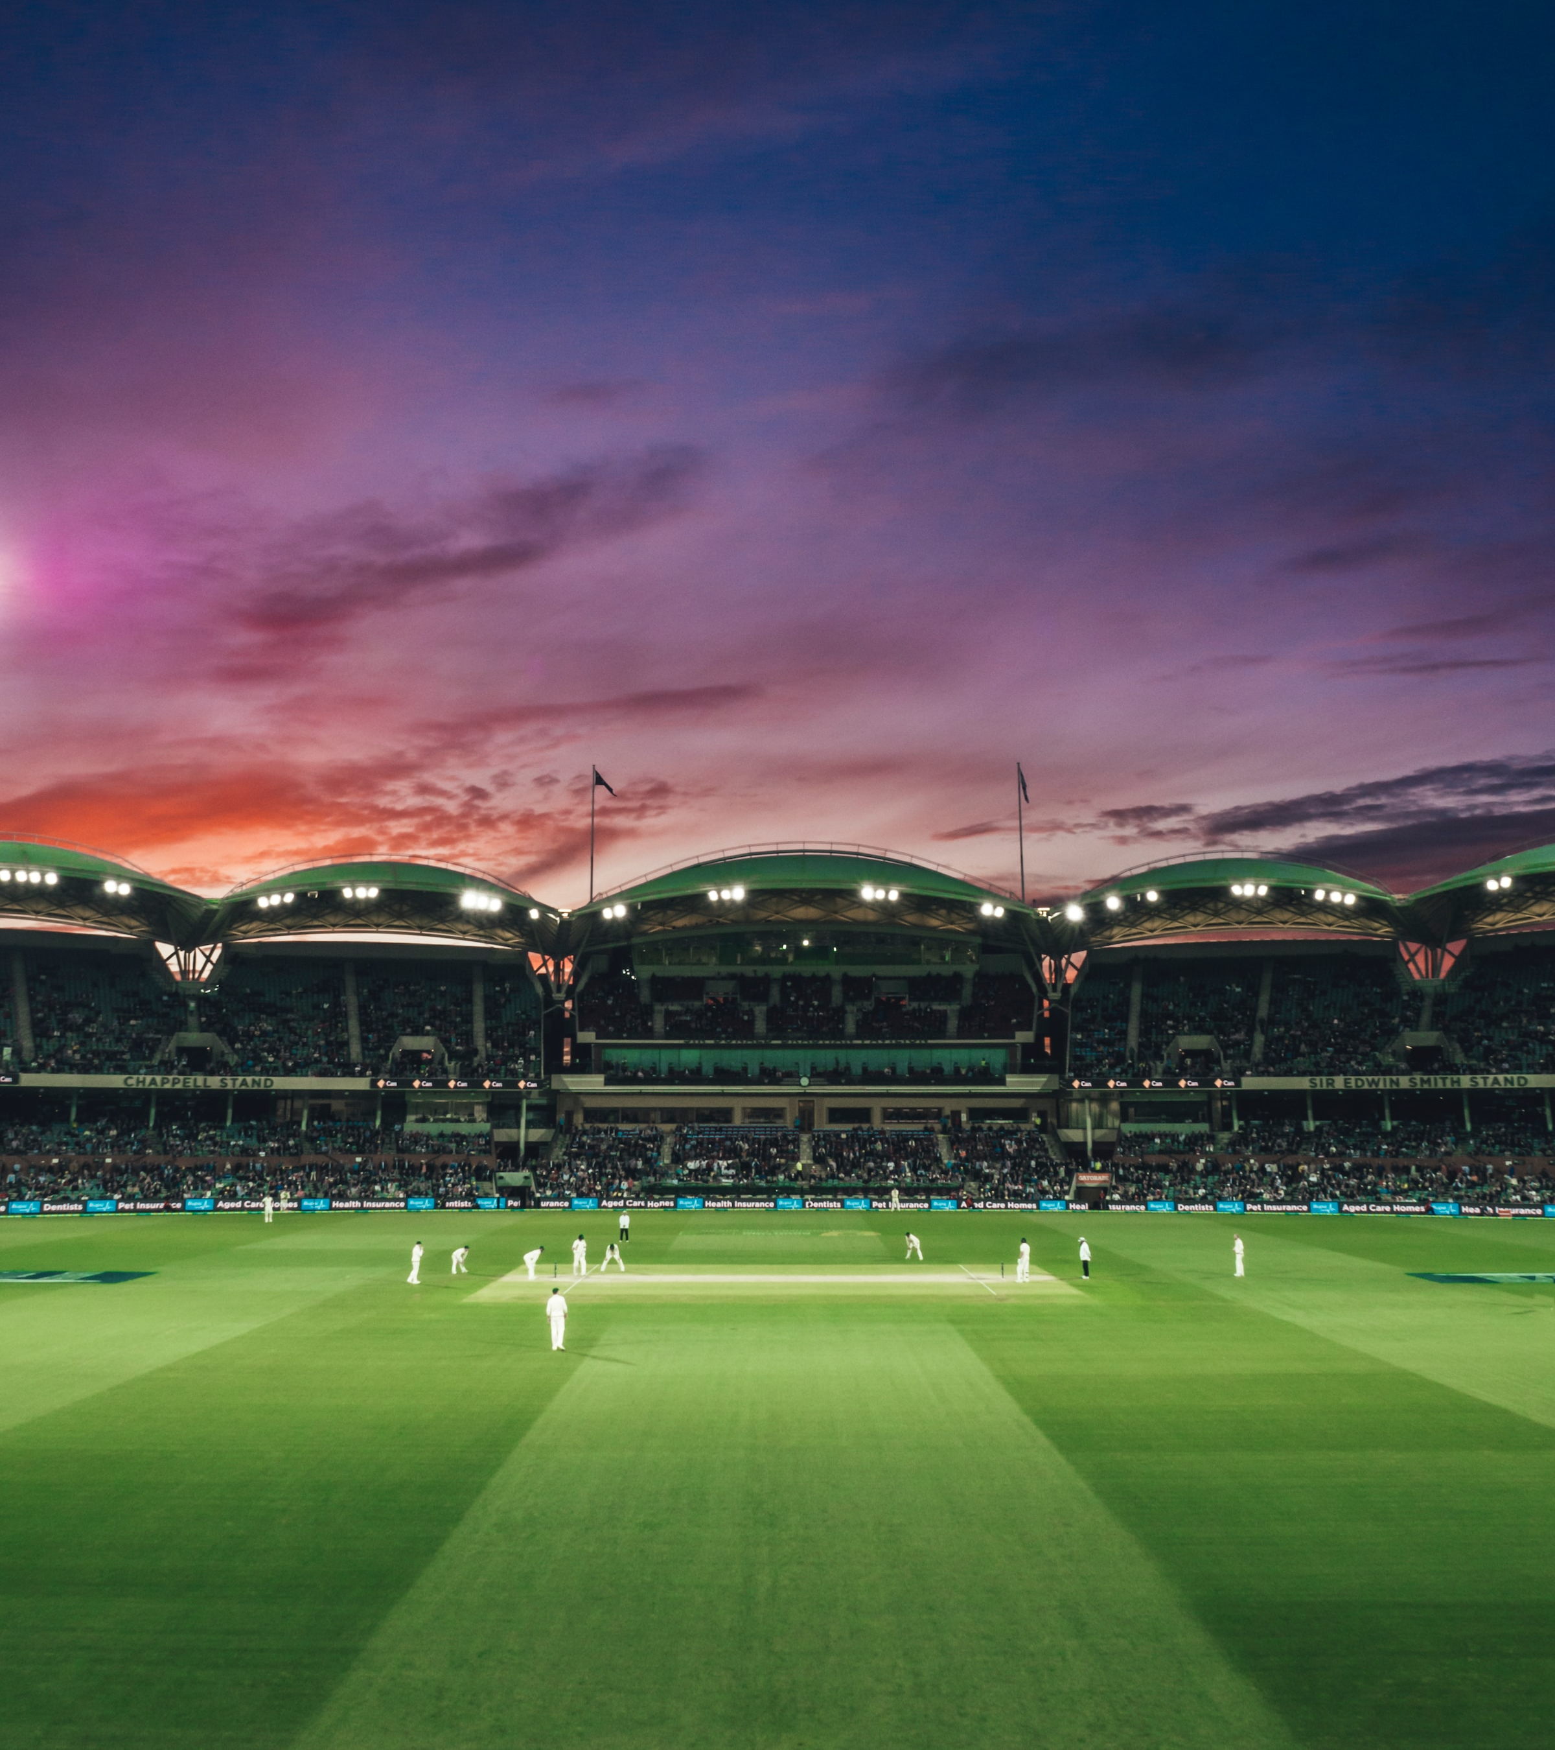


BET 8
Investment Deck
IPL Winner Prediction
Presented by: Arie Itzhacki, Vishwesh Srinivasan, Veer K. Kumar
Notes:
Welcome to our betting app BET 8, the premier destination for sports betting enthusiasts! Our app is easy to use and offers a wide range of betting options on all your favorite sports. We have a secure and reliable platform, as well as competitive odds and exciting promotions to keep you coming back for more. With our app, you can place bets on the go and track your bets in real-time. Plus, our customer service team is always available to assist you with any questions or concerns. Give our app a try and experience the thrill of sports betting like never before!

Slide 2
Agenda
Our Key Talking Points
Where We Are Now
Understanding Data
Industry Analysis
Modeling
How We Will Get There
Conclusion
Notes:
This are our key talking points and what we will be coveting during presentation, please feel free to ask any questions during the presentation.

Slide 3


Where We Are Now
The progess we've made
Notes:
We are going to talk about where we are right now and the current market conditions.

Slide 4
Market Value
10.29% CAGR
2022 - 2030
CRR
$76 billion
67% Goal
Current Market Value
CSAT
40%
85% Goal
of all network users in India gamble
28.4
Churn
Betting users average age in India
15% complete
Source: tennews.in
Source: tennews.in
Notes:
I am thrilled to announce the results of our betting app's performance over the past year. We have seen tremendous growth in both our user base and customer satisfaction, thanks to the hard work and dedication of our team and the loyalty of our users.
The current status of the market is very exciting, and we will expect a continuous growth of the market value to 2029

Slide 5


TOTAL ADDRESSABLE MARKET
106,087,457
We have about 75 million
yearly active users on the platform
BET 8
Notes:
Our app has consistently delivered a seamless and enjoyable betting experience, with a wide range of options and competitive odds on all your favorite sports. We have also introduced several new features and promotions to keep our users engaged and coming back for more. We are in a good position, but we will keep working to expand our reach in the market.

Slide 6

Industry Analysis
The business we specialize in

Slide 7



The Problem
The House Always
Win
Regulatory and Legal Issues
Processing Fees
The odds-on display never reflect the true probability or chance of an event occurring (or not occurring)
Laws and regulations associated with the industry are quite complex, so it is rather unclear whether engaging in online sports betting activities is legal or not
Related to unfavorable withdrawal terms and conditions and longer withdrawal processing times are processing fees
Notes:
This are the main problems we have identified as a company, and the reasons we want to launch this new product. Even tough we have more points on our list this are the main one to work on immediately.

Slide 8



The Solutions
1
2
3
LAUNCH INDUSTRY’S
FIRST USER FOCUS GAME PREDICTION TOOL
BUILD AN ACCESSIBLE PLATFORM ON ALL
DEVICES
GROW A COMMUNITY
OF EMPOWERED
USERS
Notes:
The solution is very direct, by using the methodologies we are going to talk about today, we will launch our prediction tool, to incorporate to our users' devices and the organically build a new community of empowered users.

Slide 9

How We Will Get There
Our next steps

Slide 10
UNDERSTAND THE DATA
1
Insights about the data that will potentially be helpful for the further steps.
2
MODELLING PROCESS
Model the machine learning models that will allow the optimization of the platform.
3
CONCLUSION
Results and future projects of the company.
Operational Plan

Slide 11
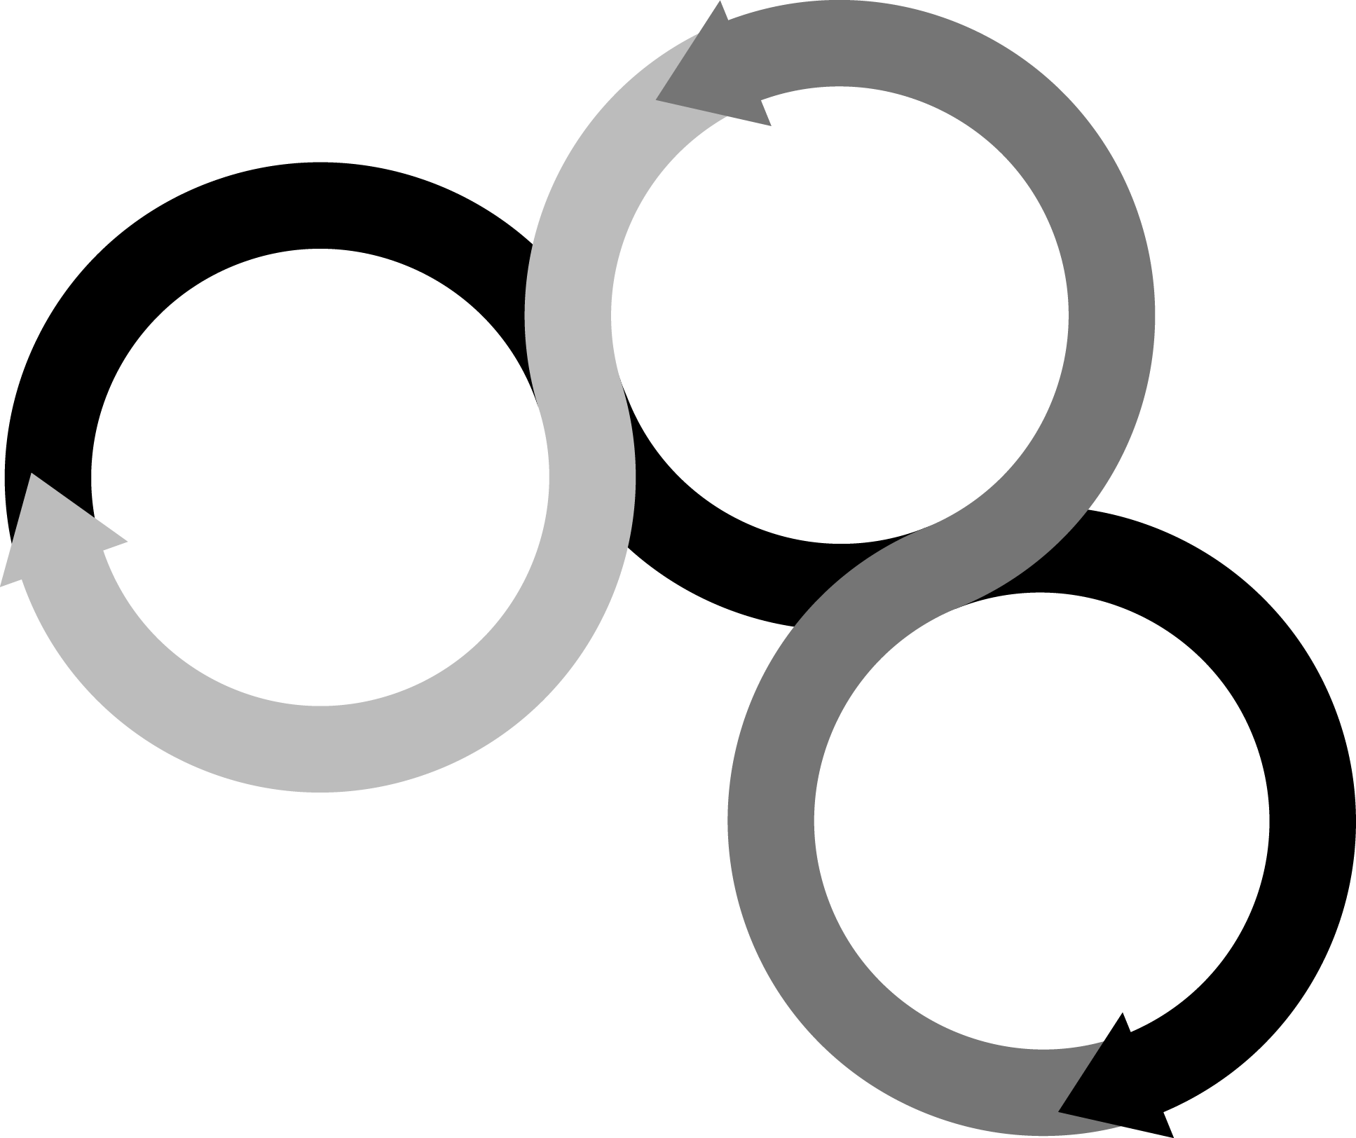



Data Overview
Web Scrapping and Coding
How do we get the data for our platform
Find and Inspect Page URL
Store the Data in the Required Format
WEB SCRAPPING
The extracted data then can be saved to a local file on your system or as a spreadsheet format. Web scraping advantages and processes can automate the processes of extracting data from the website using scripts
Notes:
The dataset we chose for analysis is called ‘matches.csv’ which contains information related to all matches from the Indian Premier League(IPL) from 2008 to 2019, this data was scrapped from the ESPN website, and we have used the csv file in our analysis of IPL matches.

Slide 12
Data Overview
Columns | Description
season | The year of the league in which the cricket matches were played
city | The city which hosted the cricket match
team1 | First team playing the match/Home team
team2 | Second team playing the match/Away team
toss_winner | Team which wins the coin toss
toss_decision | Decision taken by toss winning team to either bat or field
result | Winner of the cricket match
dl_Applied | Whether Duckworth Lewis method was applied during the match
win_by_runs | The difference in runs, team batting first won by
win_by_wickets | No. of wickets team batting second had remaining while winning the match.
Venue | Stadium where the cricket match was played
Notes:
Here we see all the columns or features present in the matches.csv file, this is a Data Dictionary or a Data Description table which describes each of our dataset columns such as season of the league, home team, away team, toss-winner, toss_decision, match results and so on.

Slide 13
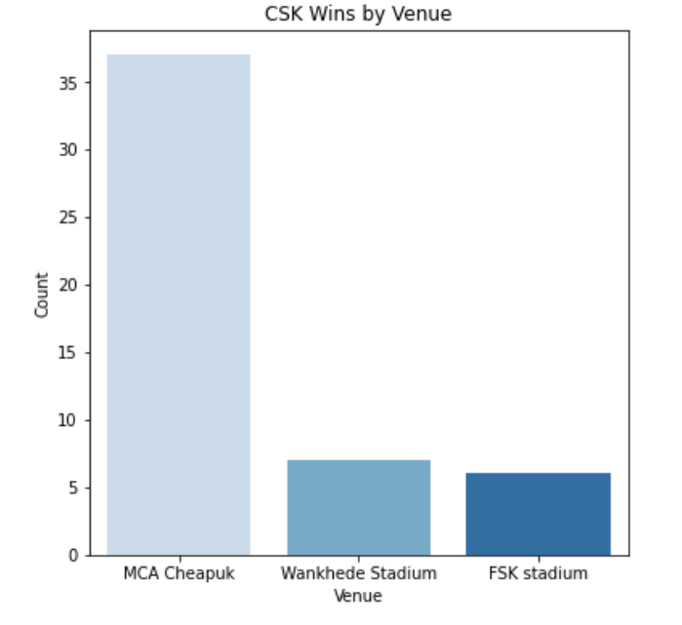
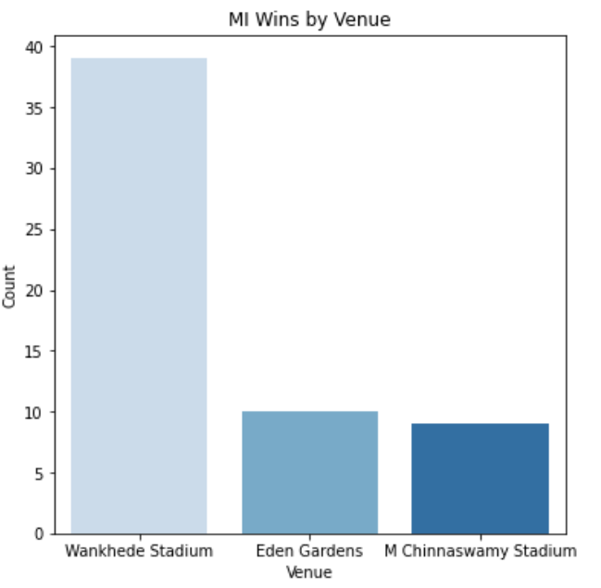
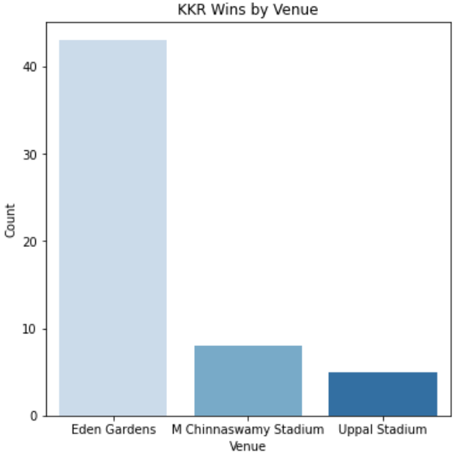
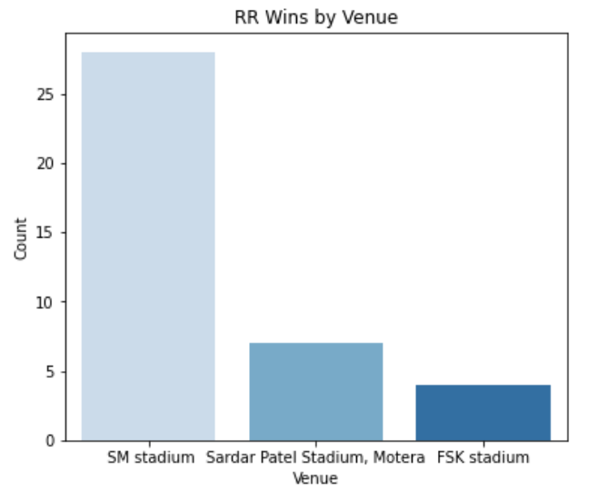

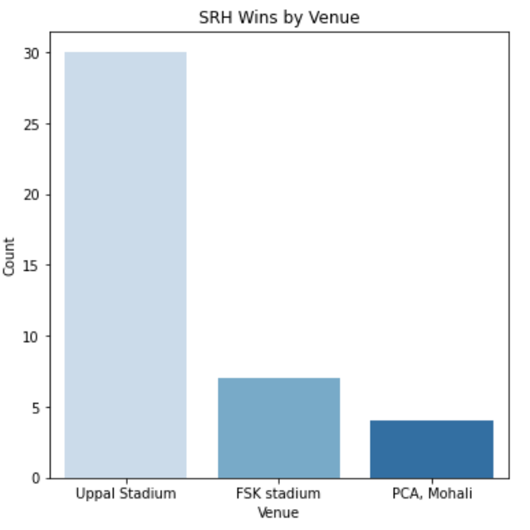
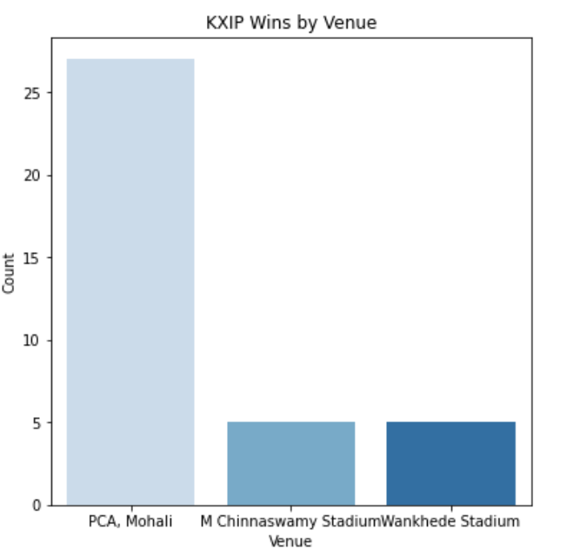

Understanding the Data
Notes:
Here we are visualising how certain teams in the IPL are more likely to win at certain venues than others, we plotted the top 3 venues where a team won most of its matches in the past ten years. For instance, we observe that most teams win at the venue that is also their home ground and there is a huge differential between the first barplot and the second barplot verifying this claim.

Slide 14
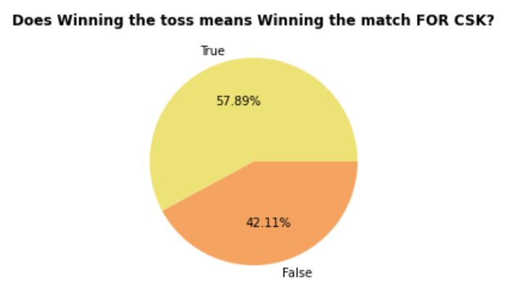
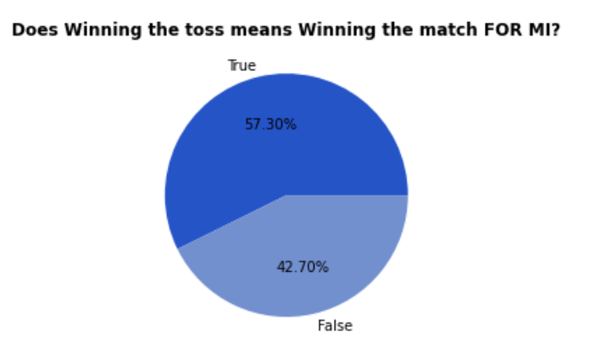
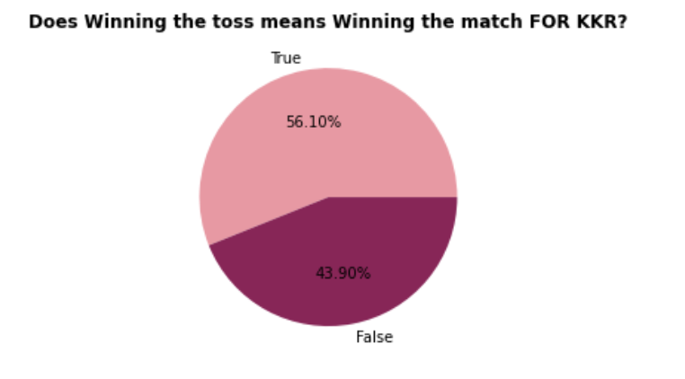
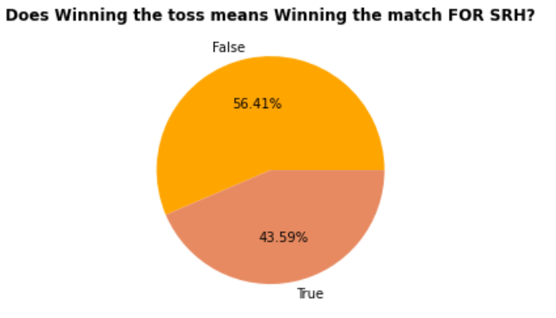
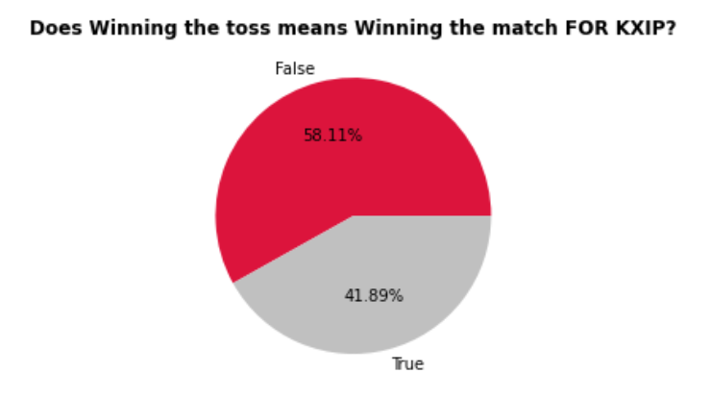
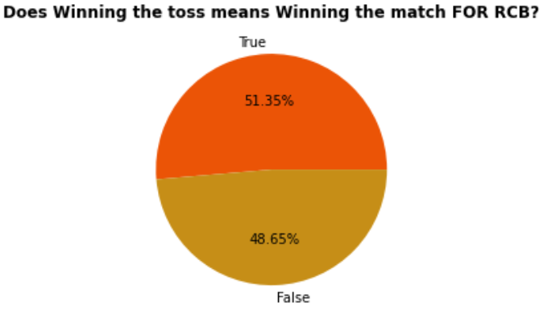
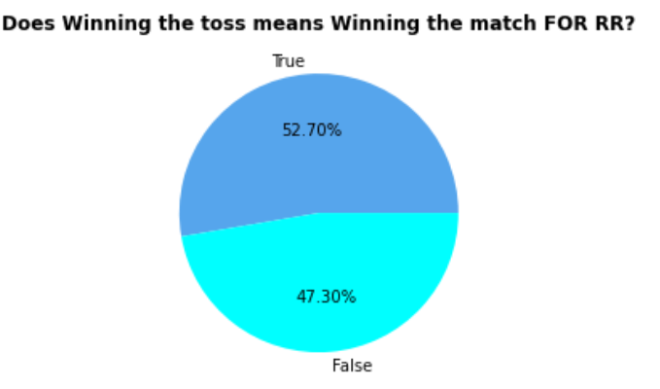
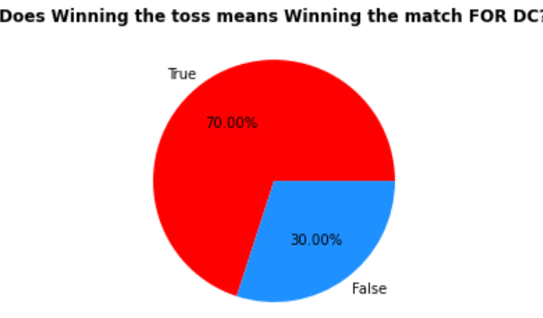
Does winning the toss means winning the match?
CSK
MI
KKR
SRH
KXIP
RCB
RR
DC
Notes:
How likely is it for a team to win he match, given that it wins the toss? and how much of a factor does winning a toss actually play for each of these team? this is what we have visualised here using pie-charts and our inference was that a team like DC(Delhi Capital) had 70% likelihood of winning the match, given they won the toss(the highest for any IPL team) while on the other end of the spectrum a team like RCB(Royal Challengers Bangalore) won only 51.35% of the matches in which they had won the toss.

Slide 15

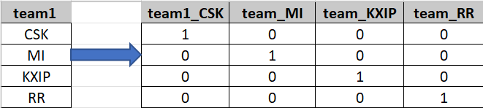
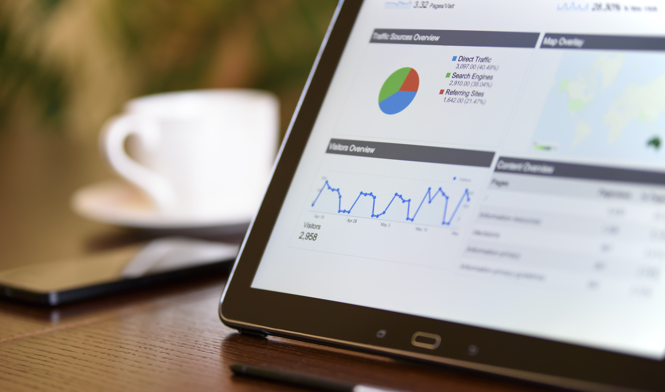
Variables are predictors to predict the ‘winner’ of a match:
The IPL season
City where the match occurred
Team 1
Team 2
Toss Winner
Toss Decision
Venue of the match
We apply the following preprocessing steps:
Encoded the output variable ‘winner’ from 1 - 8 to represent the eight teams
One hot encoded the following variables: city, team1, team2, toss_winner, toss_decision, venue
Used the 2008 - 2018 seasons data as training data
Used the 2019 season data as the test dataset
Modeling Process
One hot encoding
Notes:
We want our model to predict the winner of a match after the toss occurs. So, we would have access to the variables listed for a match after the toss. We would use all these predictors to predict the winner of the match.
The output variable is the ‘winner,’ and we encode it as 1 – 8 to represent the eight teams (MI, CSK, KKR, SRH, KXIP, RCB, RR, DC)
Instead of label encoding, the process in which we assign 1-N to categorical variables, we use the technique of one hot encoding. One hot encoding is depicted in the figure above. In this way, we prevent a machine learning algorithm to give more importance to the category equivalent to the N^{th} level than the category equivalent to the 1st level.

Slide 16
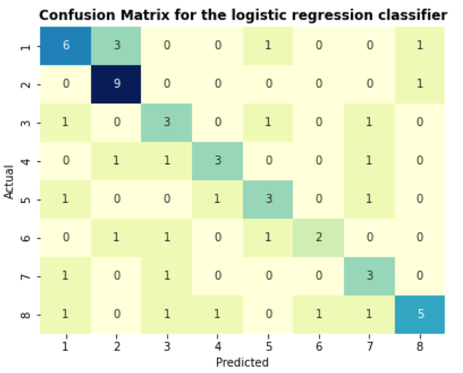
Logistic Regression
Why this model?
A simple model in which a sigmoid function is used to find a continuous value of P(Y=1) for a given input X, which is later converted to Y=0 or Y=1 based on a threshold value.
Accuracy
57.63%
Notes:
We get an accuracy of 57.63%, which is higher than the probability of choosing the winner by a flip of a coin. This shows some relationship between the predictors and the output variable.
Looking at the confusion matrix, we can infer that there are very few/no false negatives and false positives for each class of the output variable.
In logistic regression, a linear relationship between the predictors and the output variable. This maybe not true in all the scenarios, hence next we try KNN classifier, in which nothing is assumed about the data.

Slide 17
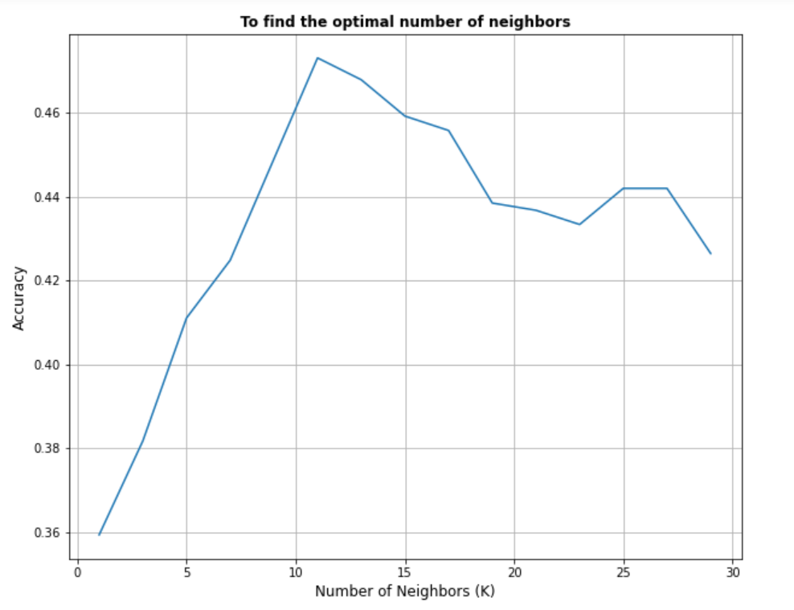
K-Nearest Neighbors
Why this model?
A model in which nothing is assumed about the data and just the nearby neighbors are looked at to decide the class of the test data point.
Accuracy
66.1% when K=11
Notes:
We perform 5-fold cross-validation at different values of K to find an optimal value for it. As we can see from the graph, at K = 11, we see the accuracy to be the highest. Hence, we then use K = 11 to fit the KNN classifier model and get a 66.1% accuracy on the test data.
Since we had performed one hot encoding, the number of features increased drastically; hence, this model’s performance may not be the best. Going forward, we try a random forest classifier, which usually performs well on categorical data.

Slide 18
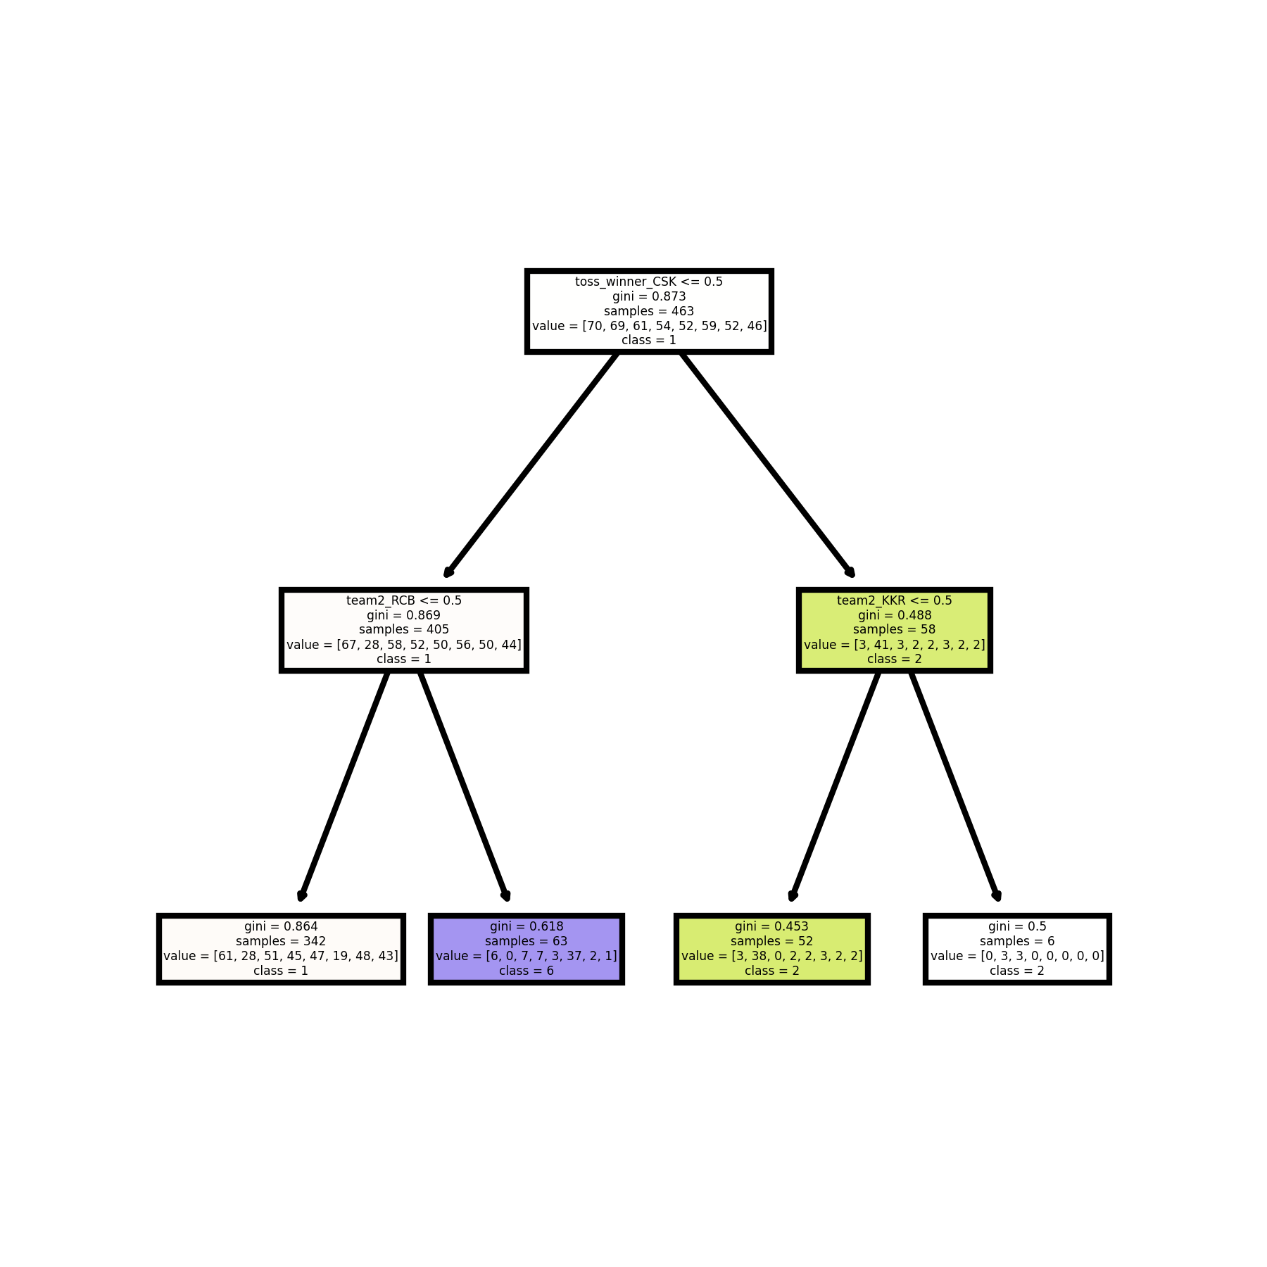
Random Forest Classifier
Why this model?
Decision trees are tree-like model of decisions and Random forest model is set of multiple decision trees to prevent overfitting. Decision tree models are ideal in our case since we have a lot of categorical data.
Accuracy
61.02%
Notes:
This image here is a simple decision tree with depth = 2 created and visualized to understand the process of random forest classifier.
We hyper-tune the following parameters: criterion, n_estimators, max_depth, and min_samples_split and perform a 5-fold cross-validation to find the best parameters.
We get the following results for the parameters:
criterion - entropy
n_estimators - 100
max_depth - 13
min_samples_split - 29
At these parameters, we get an accuracy of 61.02%.

Slide 19
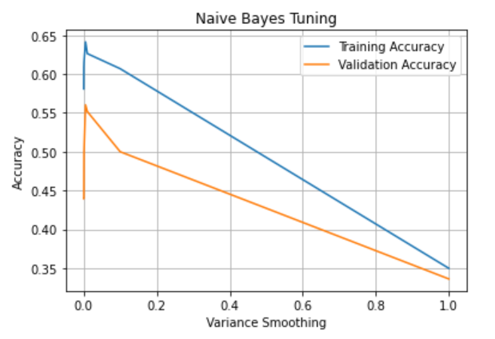
Naive Bayes Classifier
Why this model?
Since most of our predictors are independent of each other, we try Naive Bayes classifier in which the model uses the Bayes Theorem to calculate the conditional probability of an event.
Accuracy
71.2%
Notes:
We hyper-tune the variance smoothing value and find the optimal value to be 0.06. We use this value and fit the model and get an accuracy of 71.2% on the test data, which is the highest accuracy that we get out of all the classification models that we tried.

Slide 20
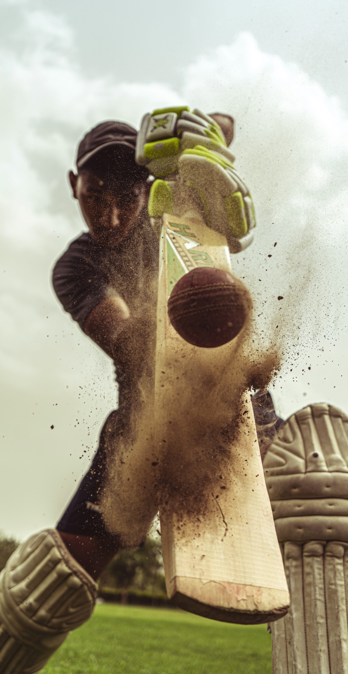


IPL Season Final 2019
Date: 12th May 2019
Viewers: 18.6 million
Predictors:
Season: 2019
City: Hyderabad
Team-1: Mumbai Indians
Team-2: Chennai Super Kings
Toss Winner: Mumbai
Toss Decision: Bat
Venue: Rajiv Gandhi International Stadium, Uppal
Our Prediction: Mumbai Indians
Actual Result: Mumbai Indians
Notes:
As mentioned earlier, we want our model to predict the winner of a match after the toss occurs. To show what our model is capable of, we would like to show a demo prediction using our model.
On 12th May 2019, the 2019 IPL season final happened at the Rajiv Gandhi International Stadium, Hyderabad, India. The match was between Mumbai Indians and Chennai Super Kings. These two teams have been the two best-performing teams across all the IPL seasons, and hence there was a lot of excitement and expectations.
You can see that from the number of viewers. There were 18.6 million people watching this game!!!
When we used this data to predict the winner of the match using our algorithm, it correctly predicted the winner to be Mumbai Indians!!!

Slide 21
Conclusion
Logistic Regression
K-Nearest Neighbors
Accuracy
57.63%
Accuracy
66.10%
Random Forest Classifier
Naive Bayes Classifier
Accuracy
61.02%
Accuracy
71.2%
Notes:
After running all our models, we can infer that Naive Bayes Classifier gave us the highest test accuracy of 71.2% while Logistic Regression gave us the least at 57.63%. For us, to build these models efficiently, we created an outline, where we started by importing data and performing cleaning operations where we dealt with null values, missing values duplicate data and redundant columns. After cleaning the dataset we performed exploratory data analysis to look at the trends in our dataset and then finally went on to build these models to achieve these accuracies.

Slide 22
Strategy Plan
OBJECTIVES
LAUNCH INDUSTRY’S
FIRST USER FOCUS GAME PREDICTION TOOL
BUILD AN ACCESSIBLE PLATFORM ON ALL
DEVICES
GROW A COMMUNITY
OF EMPOWERED
USERS
STEPS
Conduct market research
Start production stage
Launch an online advertising campaign
Employ talented engineers
Prioritize a mobile launch
Roll out mobile version to Premium users first
Hire community specialists
Launch giveaway to boost enthusiasm
Create more social media content
Notes:
This are the main strategy points for our short-term goals, but we are also considering five other main points:
User acquisition and retention: Our top priority is to attract and retain a large and engaged user base. We will focus on marketing and advertising efforts to drive awareness and interest in our app, as well as offering a seamless and enjoyable user experience to keep users coming back. We will also implement loyalty programs and other incentives to reward our most active users.
Product innovation and development: We will continue to invest in research and development to bring new and innovative features and functionality to our app. This includes adding support for new sports and markets, as well as introducing new betting options and features to enhance the user experience.
Partnerships and collaborations: We will seek out strategic partnerships and collaborations with sports leagues, teams, and other organizations to enhance the value of our app and drive user acquisition and engagement. This may include sponsorship deals, exclusive content and data rights, and other collaborative opportunities.
Regulatory compliance: As a regulated industry, it is essential that we remain compliant with all relevant laws and regulations. We will work closely with legal counsel and industry bodies to ensure that our app and business practices are fully compliant at all times.
Financial management and growth: We will focus on maximizing profitability and driving sustainable long-term growth for our business. This includes carefully managing expenses and optimizing revenue streams, as well as exploring opportunities for expansion and diversification.

Slide 23
User increase of 80,000,000
BY THE HALF-YEAR
Reach 50% of our target
revenue by the third quarter
Key Performance Indicators
100% growth on all our social media groups by
THE YEAR-END
Notes:
As a betting app, some key performance indicators (KPIs) that we will track and measure include:
User acquisition and retention: We will track the number of new users acquired on a monthly basis, as well as the retention rate of existing users. This will help us understand the effectiveness of our marketing and user acquisition efforts, and identify areas for improvement.
Revenue and profitability: We will track total revenue generated from our app, as well as the profitability of our business. This will help us understand the financial health of our company and identify opportunities for growth and improvement.
User engagement: We will track the frequency and duration of user sessions, as well as the number and value of bets placed. This will help us understand how engaged our users are with our app and identify opportunities to increase user engagement.
Customer satisfaction: We will track customer satisfaction through surveys and other methods to understand how well we are meeting the needs and expectations of our users.
Operational efficiency: We will track key operational metrics such as the speed and reliability of our app, as well as the efficiency of our internal processes. This will help us identify opportunities to improve the overall user experience and efficiency of our business.

Slide 24



The Leadership Team
Arie Itzhacki
Vishwesh Srinivasan
Veer Kumar
Chief Financial Officer
Chief Technology Officer
Chief Operations Officer

Slide 25
Phone Number
123-456-7890
Questions?
Email Address
Reach out to us for
concerns and clarifications
hello@bet8.com
Website
www.bet8.com

Slide 26

Bet 8
Thank you!
Feel free to approach us
if you have any questions.

Slide 27
Appendix

Slide 28
Drawbacks
Logistic Regression
K-Nearest Neighbors
It learns a linear relationship from the given dataset and then introduces a non-linearity in the form of the Sigmoid function. Hence when there is non-linear relationship between the inputs and the output variable, this model doesn't perform well. Another assumption made here is that all the predictors are not correlated.
Since we have a lot of categorical columns, after we do one-hot encoding, the number of columns drastically increase and usually KNN algorithm is not ideal for large datasets due to the computational requirements.
Random Forest Classifier
Naive Bayes Classifier
Random forests uses the concept of bagging and feature randomness to build uncorrelated forest of trees. The assumption made here is that in the process of bagging, the sample is representative of the whole training dataset. Another requirement here is that the all the features have some predictive power. When these assumptions fail, the model would not perform that well.
Naive Bayes makes an important assumption that all the predictors are independent. In our case, even though most of them are, some are not. For example, the probability of a team to win at a particular venue may change based on its opponent. Hence this factor could degrade the performance of the classifier. Another assumption made here is that all the predictors have an equal effect on the outcome.

